Slide 1

Root cause analysis
Problem solving

Slide 2


We have built an application

Slide 3
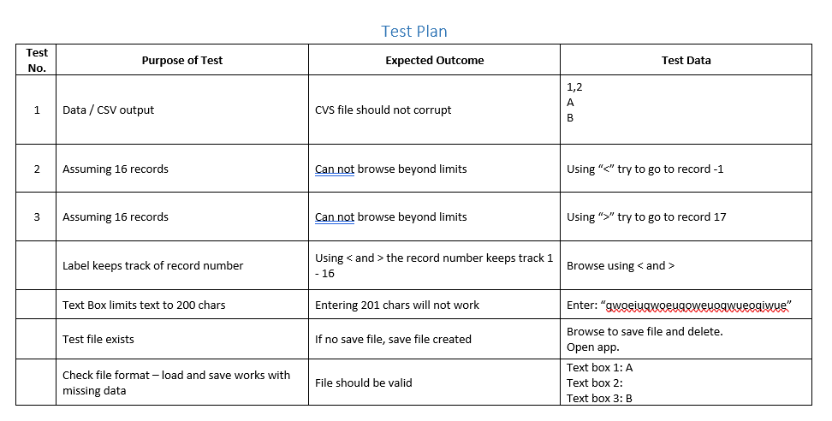
And tested the application: - test plan - Test LOG

Slide 4
What happens when we find bugs?
The tests are planned
We look at the requirements specification
And at the code
And think about all the tests we need to run
Then we run them and … we find bugs!
What next?

Slide 5
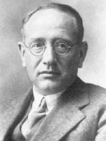
Problem solving!

Slide 6
Polya’s Problem Solving Strategy
First principle: Understand the problem
Second Principle: Devise a plan
Third principle: Carry out the plan
Fourth principle: Look Back

Slide 7
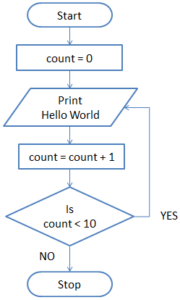
Logic errors
Functional spec
Check the logic against the flowchart
And pseudocode

Slide 8
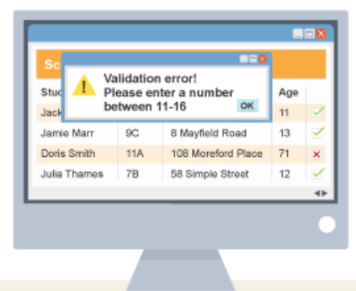
Data errors
Errors with data entry?
Presence check
Length check
Type check
Format check
Range check
Check digit
https://www.bbc.co.uk/bitesize/guides/zdvrd2p/revision/1

Slide 9
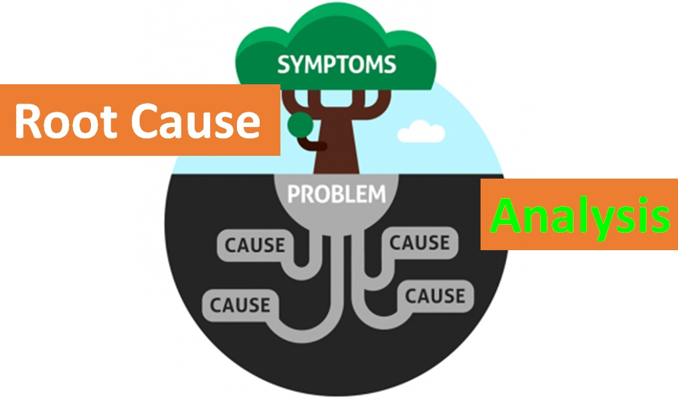
There is a bug – why?
We can fix the bug, but why did it happen?
There are lots of reasons that bugs occur
Often we want to get to the root cause
So that this type of mistake doesn’t happen again

Slide 10
Five whys
The 5 WHY analysis is a simple and very effective technique
By repeatedly asking the question WHY, you can peel away the layers of symptoms
Leads to the real, underlying Root Cause of a problem
5 is an arbitrary number, but it seems to work

Slide 11
Write down the problem. Writing helps you to formalize the problem and describe it completely. If you work with a team, it also helps the team to focus on the same problem.
Ask yourself why did the problem happen and write down the answer.
Ask yourself – looking at your answer – again why did the problem happen, and write down the answer.
And again, ask yourself – looking at your answer – why did the problem happen.
Ask yourself this question as often as necessary until the team agrees that the problem’s real root cause is identified. This may take fewer or more times than 5 WHYS.

Slide 12


Task 1
Create a three page document
Page 1: 5 whys guide – write a guide for a team to follow
Page 2: Create a form for the team to fill in that helps them follow the five whys. They should write each step until they identify the root cause.
Page 3: A form for the team to fill in with an action plan to address the problem
https://blog.superhuman.com/five-whys-method/

Slide 13
Task 2: report
Write a report on:
Logic errors
Data errors
Root cause analysis

Slide 14
Helpful links
https://www.michigan.gov/-/media/Project/Websites/mde/2020/04/02/5_Whys_Worksheet.pdf?rev=1a4a151a2fbf4e56a0f88dd1ad43452f

Slide 15
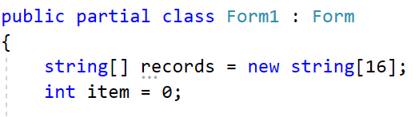
Changing the number of items
Customer requests that the application saves 32 items

Slide 16
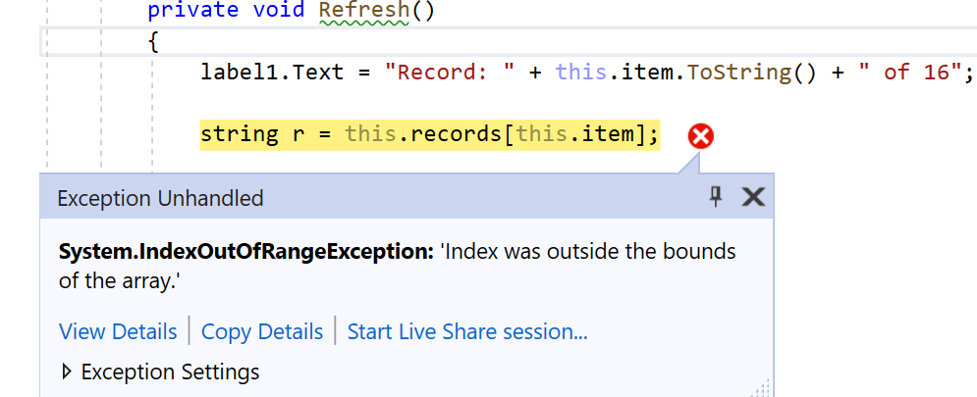
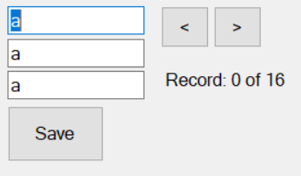
Five whys
Training?
Spec?
Customer?
Pair programming?
Code reviews?

Slide 17
task
Complete the testing documentation
Run the tests and find a bug (or many)
Apply root cause analysis to the bug
Fix the bug
Copy the test plan – for the tests that failed
Run the tests to confirm the application works
Confirm against spec - cards

Slide 18
report
Write a report on:
Logic errors
Data errors
Root cause analysis
The five whys

Slide 19
Things to check
Card info
Length check
Type checks
File format (escaping comma)
File exists?
Array length check – change array length – does it break the code?

